Slide 1

IT5002
Computer Systems and Applications
Welcome to IT5002
colintan@nus.edu.sg

Slide 2
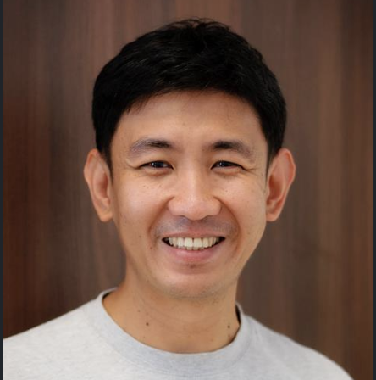
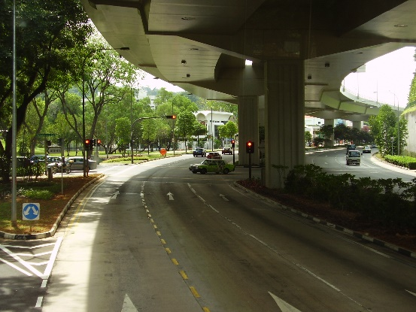
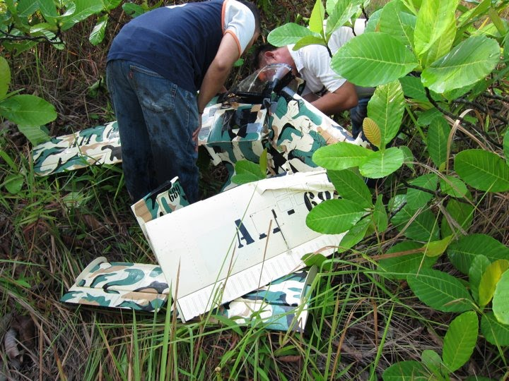
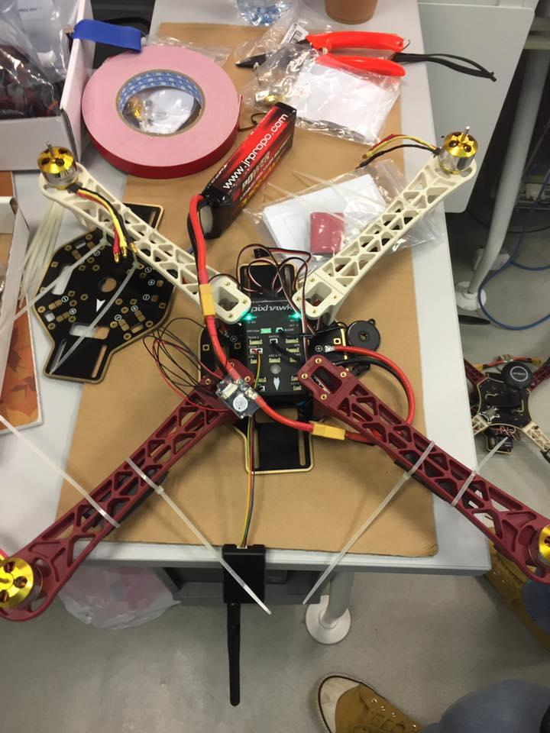
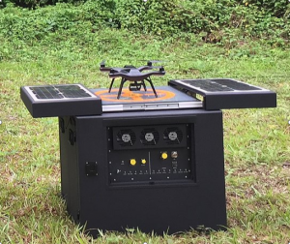
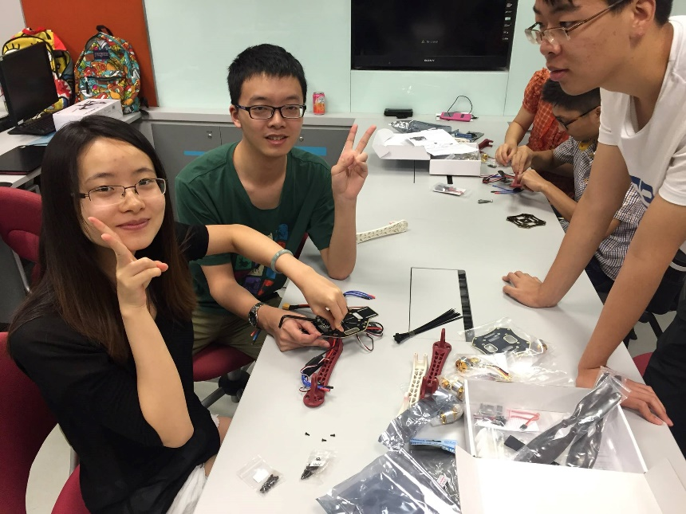
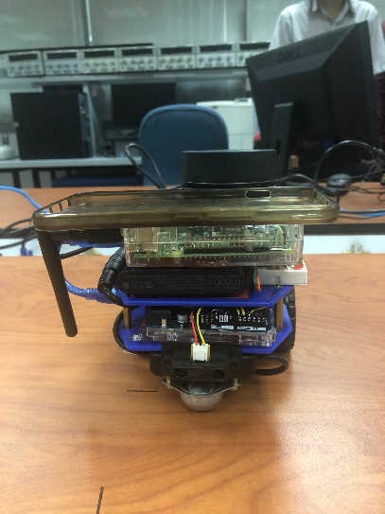
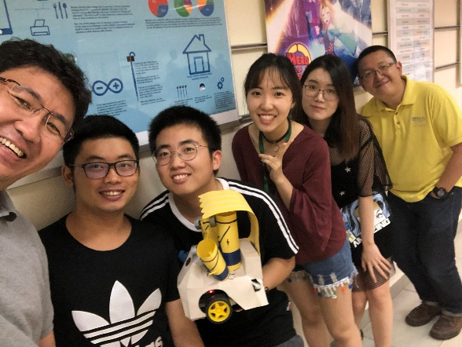
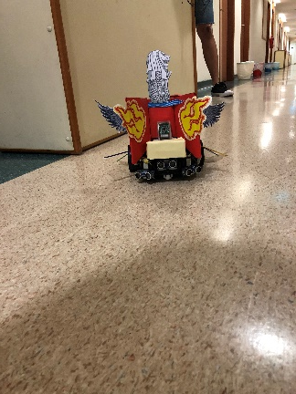
Colin Tan
Consultation:
By appointment
Email: colintan@nus.edu.sg
Admin appointment:
Chief Randomness Generator,
Makers@SoC

Slide 3
IT5002 Computer Systems and Applications
Course Objective
The objective of this module is to familiarise students with the fundamentals of computing devices and applications
  This is a fast paced, intense course.
  But you will learn a lot.
Topics
  Part 1: Processor Organization
    Interfacing High Level Programming Languages to Hardware.
    Data representation and number systems
    Assembly language
    Processor datapath and control
    Pipelining (Brief)
    Cache (Brief)
  Part 2: Operating Systems

Slide 4
IT5002 Computer Systems and Applications
Course Objective
The objective of this module is to familiarise students with the fundamentals of computing devices and applications
  This is a fast paced, intense course.
  But you will learn a lot.
Topics
  Part 1: Processor Organization
  Part 2: Operating Systems
    OS Architecture.
    Process Management
    Process Coordination
    Memory Management
    File Management

Slide 5
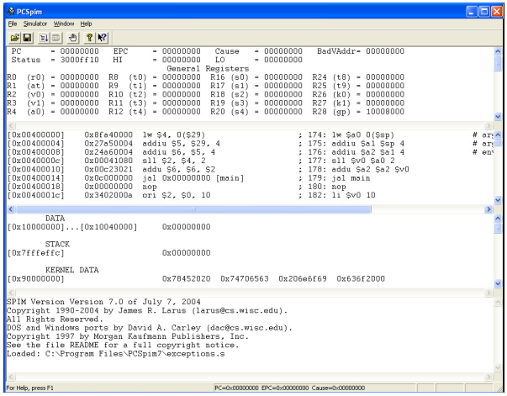
Practical Aspects
  Tutorials / Labs most Fridays, 6.30 pm to 7.30 pm or 7.30 pm to 8.30 pm from Week 3 onwards
    Tutorials
    Lab sessions

Slide 6
Assessment
CA component | Weightage
Tutorials / Labs | 5%
Assignment | 15%
Mid-Term Test* | 25%
Final Exam* | 55%
* Face-to-Face Electronic Assessments (Examsoft). Two-page cheat-sheet (ONE A4 sheet)

Slide 7
Admin Matters
Lectures are 3 hours long, every Tuesday 6.30 pm to 9.30 pm
All course materials will be uploaded on Canvas.
Tutorials/Labs start in week 3 (29 August 2025)
Mid-term test
  Tuesday 30 September 2025, 7 pm to 8 pm (during lecture slot)
    In person electronic assessment. 2-page cheat sheet (single A4 sheet)
  Please check Canvas announcements for updates
Please post your queries on Canvas forums
  Everybody can help answer and everybody can read the answers
  Email me at colintan@nus.edu.sg only for personal matters

